Slide 1

Metropolitan College
Project:
Type II Diabetes Management Web-Based Application
A Teaching tool for the BU Health Informatics Course
Iteration #2 – 11/7/2013
CS673 Software Engineering
Fall 2013

Slide 2
Architecture
View
Controller
Model
Users
edit, index
password
profile
signup
usersController
Login(), Logout()
Add(), edit(), delete(), show(), sign_up(), password()
Activate(), deactivate()
users
patients
- diagnoses
- drug_allergies
- visits
- medhistory_complaints
- vitals_labs
- treatments
- treatment_medicines
medicines
Patients
search
add
edit
show
patientsController
search()
add()
edit()
show()
delete()
Visits
index
add
show
gcalgorithm
edit
visitsController
index()
add()
show()
gcalgorithm()
edit
Medicines
add
edit
View all
view
medicinesController
add()
view()
list

Slide 3
Implementation & Refactoring
Form Helpers
Forms closely match models
Auto-populate fields that persist between submissions
Keeps logic in the controller and out of views
Makes view file cleaner and easier to read and maintain
Tab style layout for Patient Data
Used to organize data
User friendly
Database
Updated to limit patient access by user

Slide 4
Project Management - Metrics
Total Lines of Code: 3733
Model: 646
View: 1706
Controller: 696
Database: 181
Algorithm:306
Total number of defects: 35
Open: 15(13 bugs and 2 enhancement)
Closed: 20(13 bugs and 2 enhancement)
Metric | total
Code Lines | 3733
Defect density | 12/3.733
Achieved requirement proportion | 8/10
Programmer productivity | 3733/(16+13+15+12+10.5+28+22+9+27)=29.745
Test cases passed rate | 21/31

Slide 5
Testing
Unit Tests: test every page and function.
Module Tests:
Test the User Module—sign up, log in, user management, profile management…
Test the Patient Module, Visit Module, etc.—add, update, search, delete
Test the Algorithm
Integration Test:
A complete process using this system

Slide 6
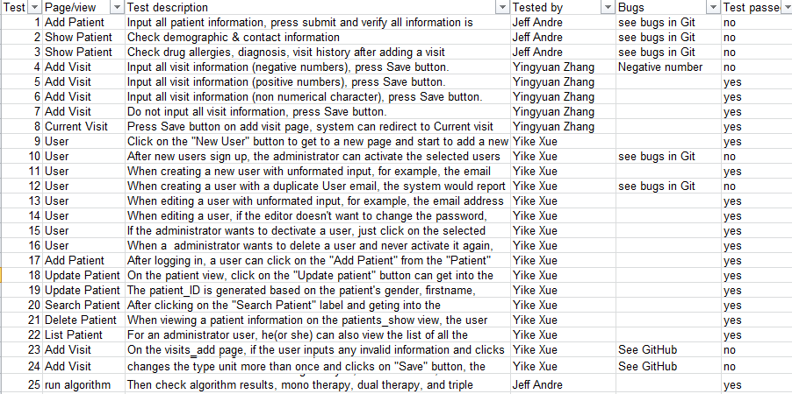
Some Test Cases
Applying the TDD concept to our project
No matter the user got into which page in our software, he or she will see the BU logo on the center bottom of the page.
When the user input a new lastname(Black), which is different from the former lastname(White), then submit the update data, the patient information would be update but the patient_ID remains the same.

Slide 7
User Stories for Iteration # 2
Completed
User Login and Registration
Add Visit
View Visit
Current Visit
Run Algorithm
Accept or Edit Algorithm Results
Limit Patient Access by User (new requirement)
List Patients ( new requirement)
Not Complete
Input validation
Algorithm contraindication checking

Slide 8
Progress & Lessons Learned
Progress
User stories completed except Input validation
Started on 3rd iteration stories
Lessons Learned
Testing & integration needs more time so start early
Keep track of test cases and fix bugs early

Slide 9
Future Work
3rd Iteration User Stories
Input Validation
View patient with tabs
Add/Update/View medication table
Algorithm checks contraindications
Calculators
After this Project
Implement more diabetes management algorithms
Summarize challenges in implementing medical algorithms for a clinical decision support system (CDSS)

Slide 10
Thank you!

